Slide 1
WATER FALL & AGILE
Agile introduces a product mind set with a focus on customer satisfaction
Waterfall focuses on Successful project delivery
Agile separates a project into sprints. waterfall divides a project into phases
Requirement are Prepared everyday in agile ,while requirements are prepared once at the start in waterfall model

Slide 2
WATERFALL & AGILE
Agile allows requirement changes at anytime waterfall avoid scope changes
Testing is performed concurrently with development in Agile. Testing Phases only comes after the build phase in waterfall model

Slide 3
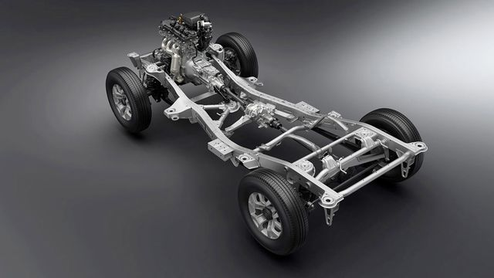
Ladder frame
CAR DEVELOPMENT
Example: for waterfall model
1
WATER FALL MODEL CREATE FLOW CHART FOR THE CAR DEVELOPMENT AS SHOWN FIG

Slide 4
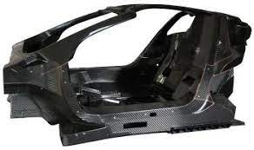
Body of the car
example
2
AS PER THE FLOWCHART IN THE WATER FALL MODEL DEVELOPER DEVELOP THE BODY MODEL CUSTOMER EXACTLY DON’T KNOW THE END PRODUCT DESIGN

Slide 5
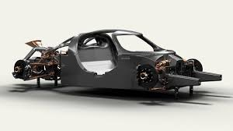
Partially developed car
IN AGILE DEVELOPER DEVELOP PARTALLY ACCORDING TO THE REQUIREMNT ANY FUTURE CAN BE ADD OR REMOVE FROM THIS MODEL CLIENT WILL BE IN TOUCH WITH DEVELOPMENT TEAM
3

Slide 6
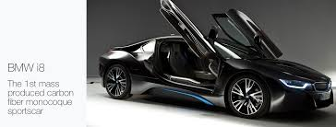
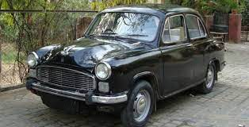
car
4
CLIENT ALONG WITH THE DEVELOPMENT TEAM .
CLIENT SATISFACTION CAN BE DONE BY AGILE PROCESS
4
IN WATER FALL MODEL CLIENT DON’T KNOW THE EXACT PEODUCT AS PER THE REQUIREMENT DEVELOPER UNDERSTANDING HE WILL DEVELOP. IT MAINLY COCENTRATE ON PRODUCT DELIVERY

